Slide 1


Package | Description
teleop_grasp | Project package of the teleoperation system.
teleop_grasp | Integration of the teleoperation pipeline.
franka_ros | ROS integration of Franka robot.
franka_gazebo | Simulation of the Franka robot in Gazebo.
...
franka_controllers | ROS Control controllers for the Franka robot.
hand_tracking | Hand pose- and gesture estimation using MediaPipe.
ros_utils | Utilities for interfacing ROS/Gazebo/MoveIt/Eigen etc.

Slide 2
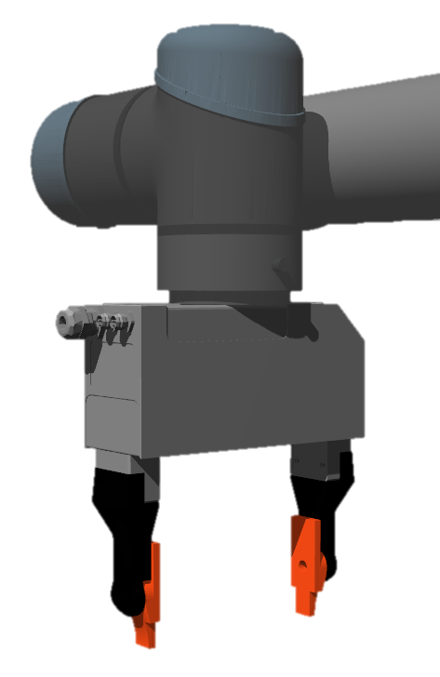
Flange (EE)
Gripper (TCP)

Slide 3
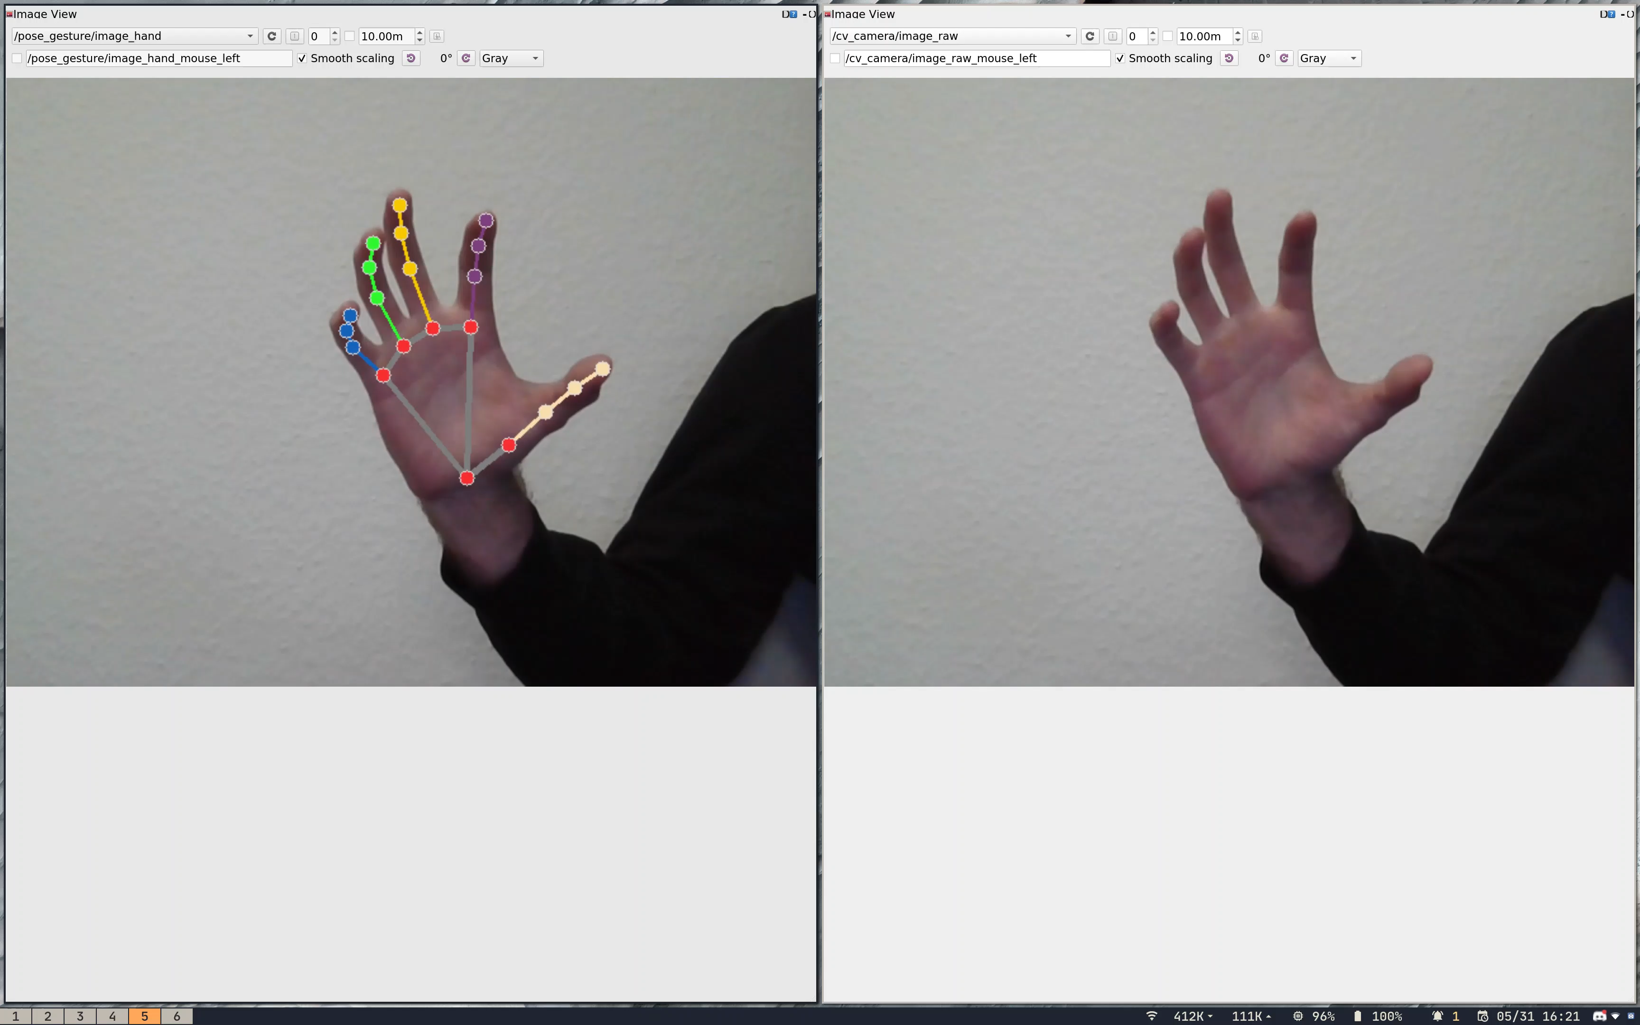

Slide 4
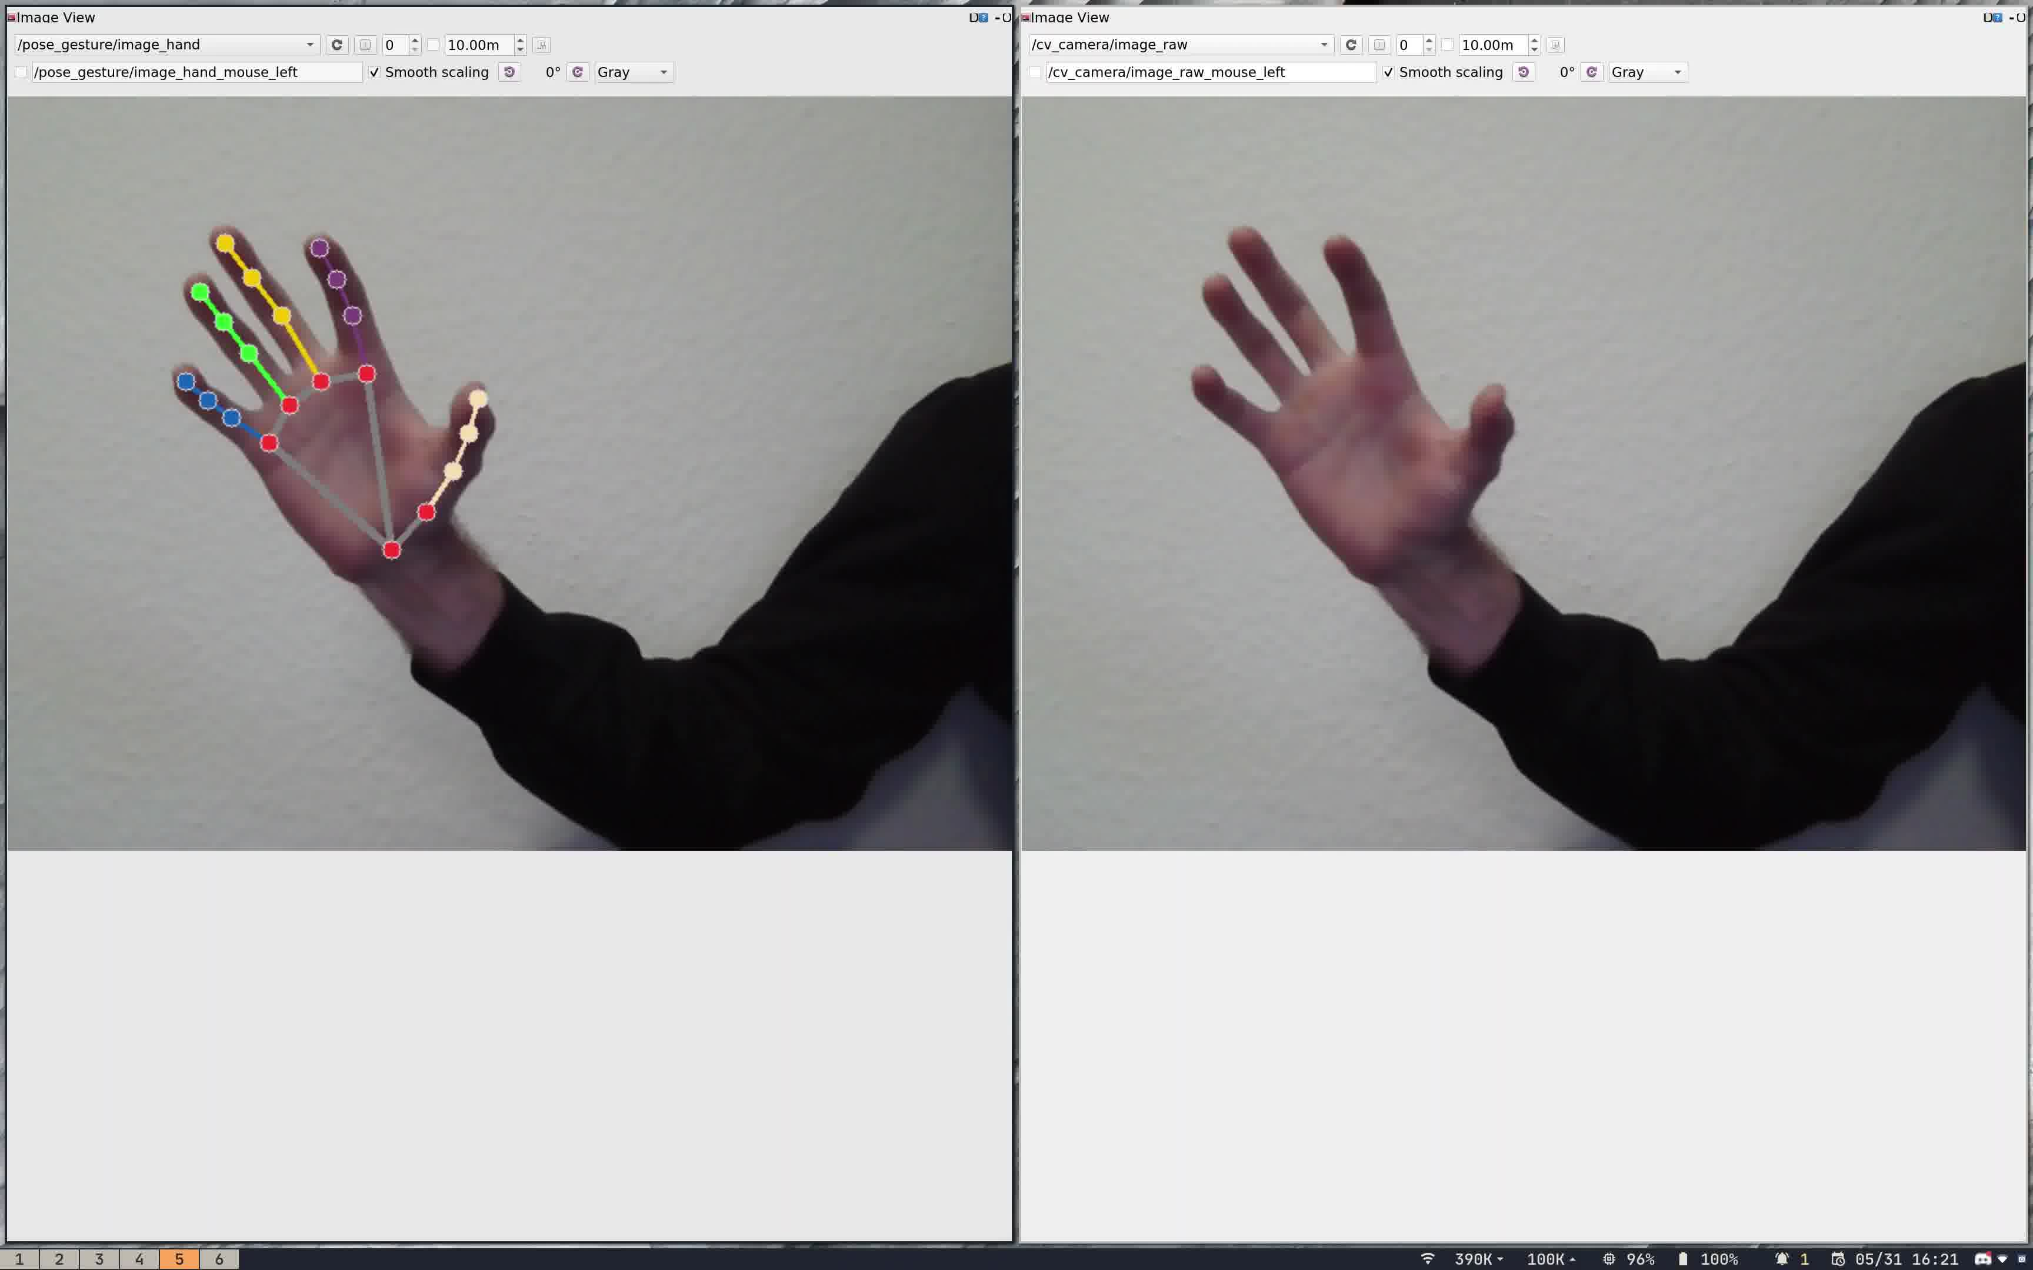
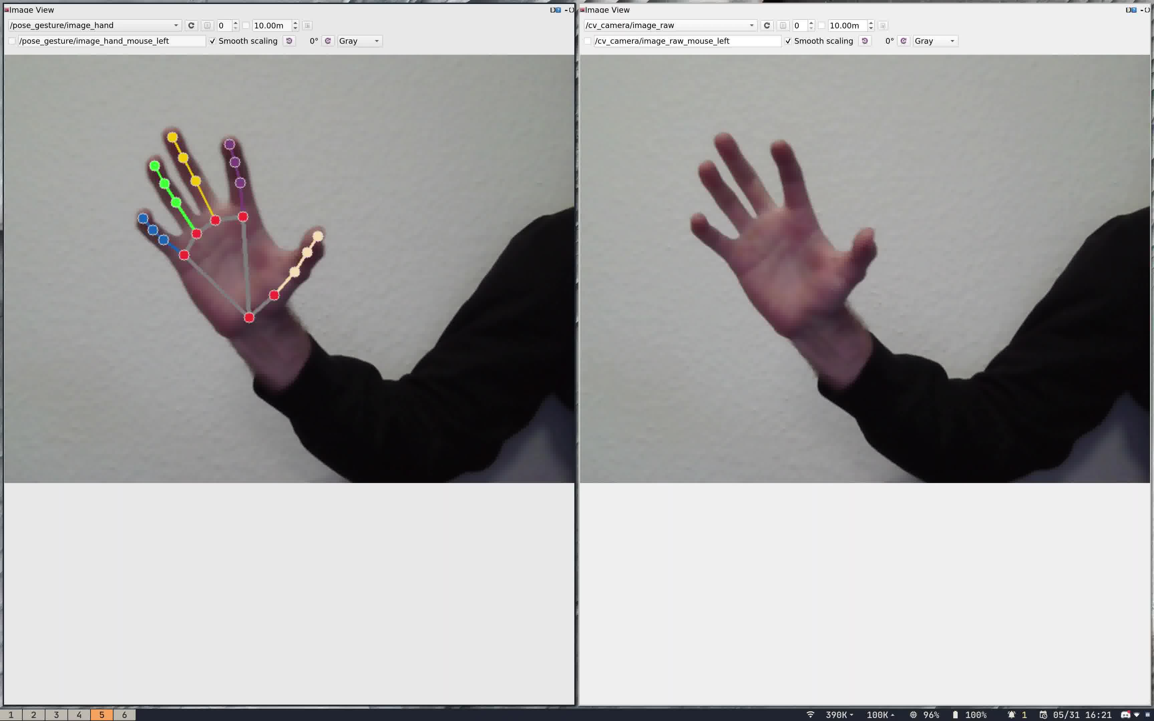
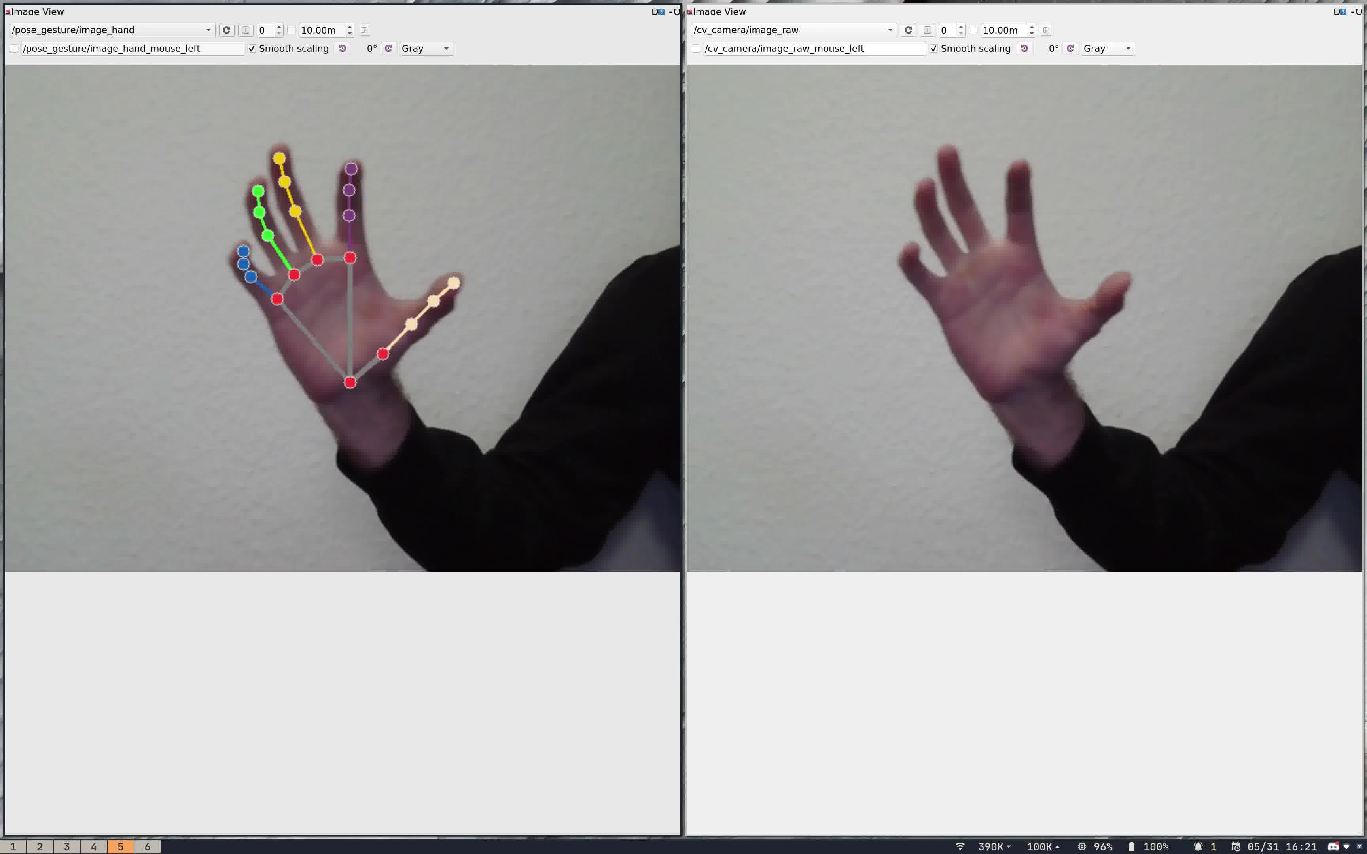
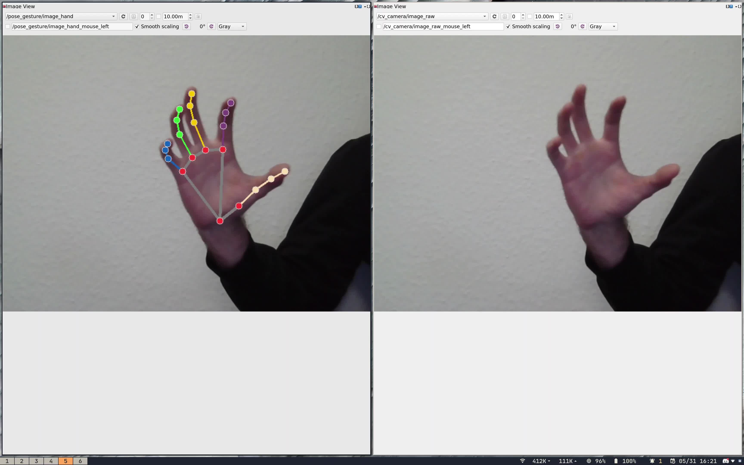
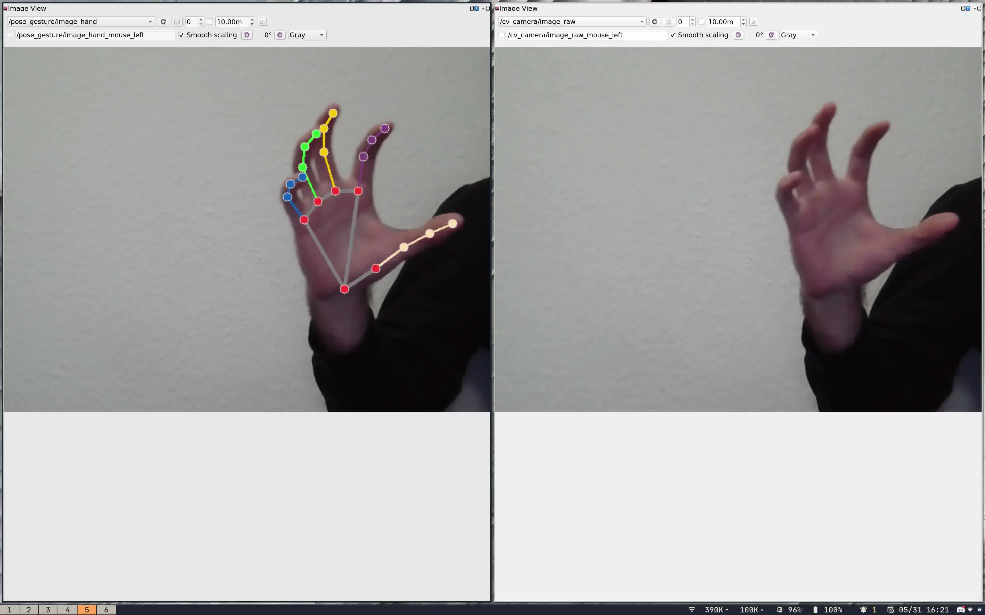
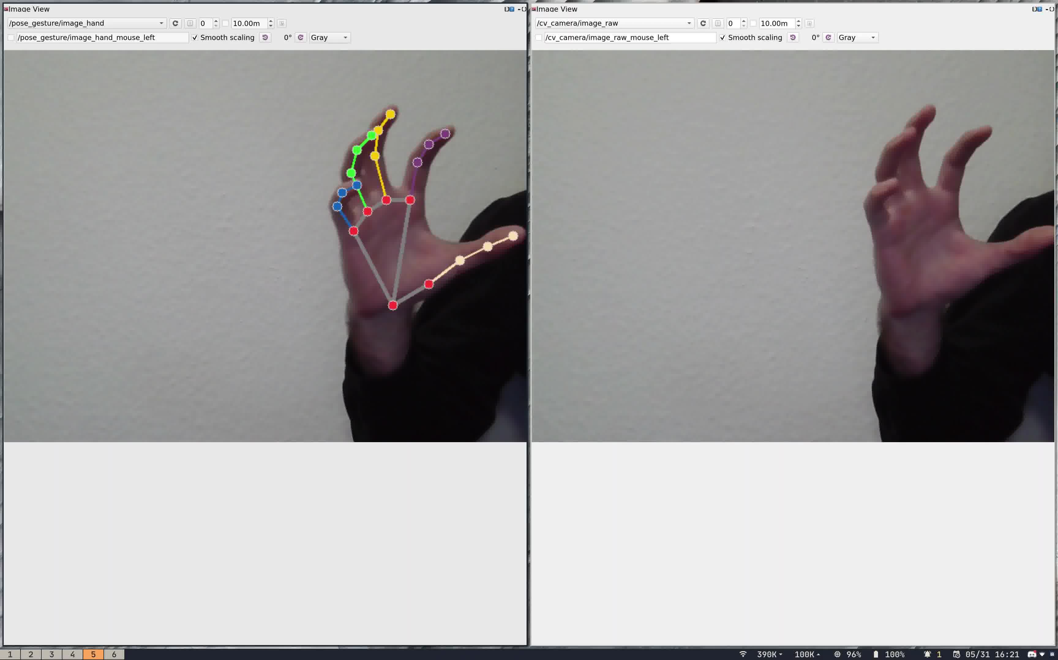
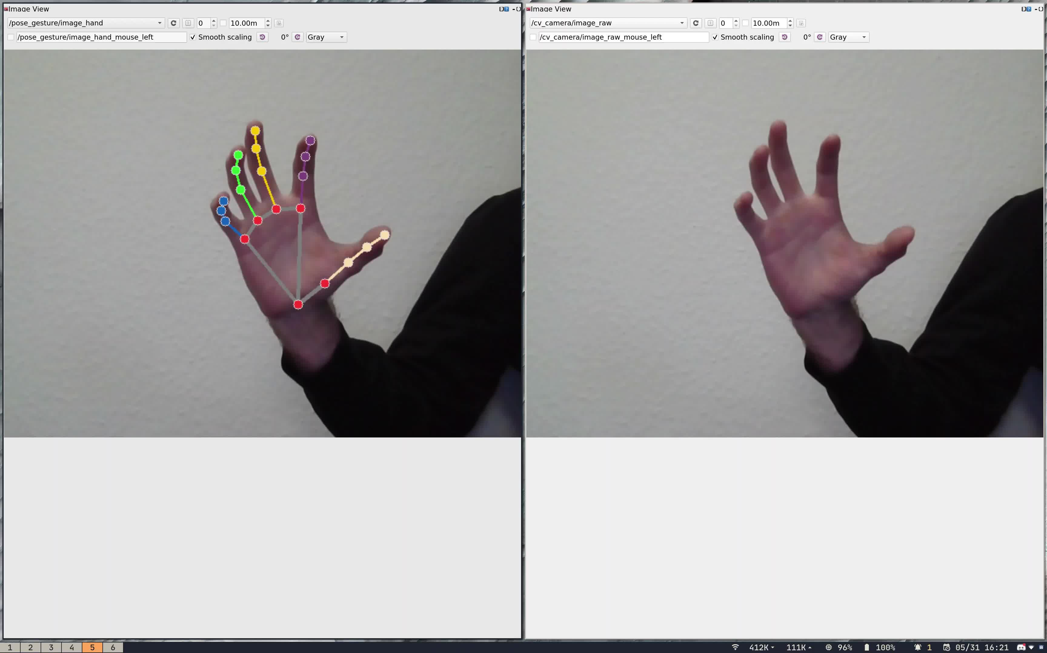

Slide 5
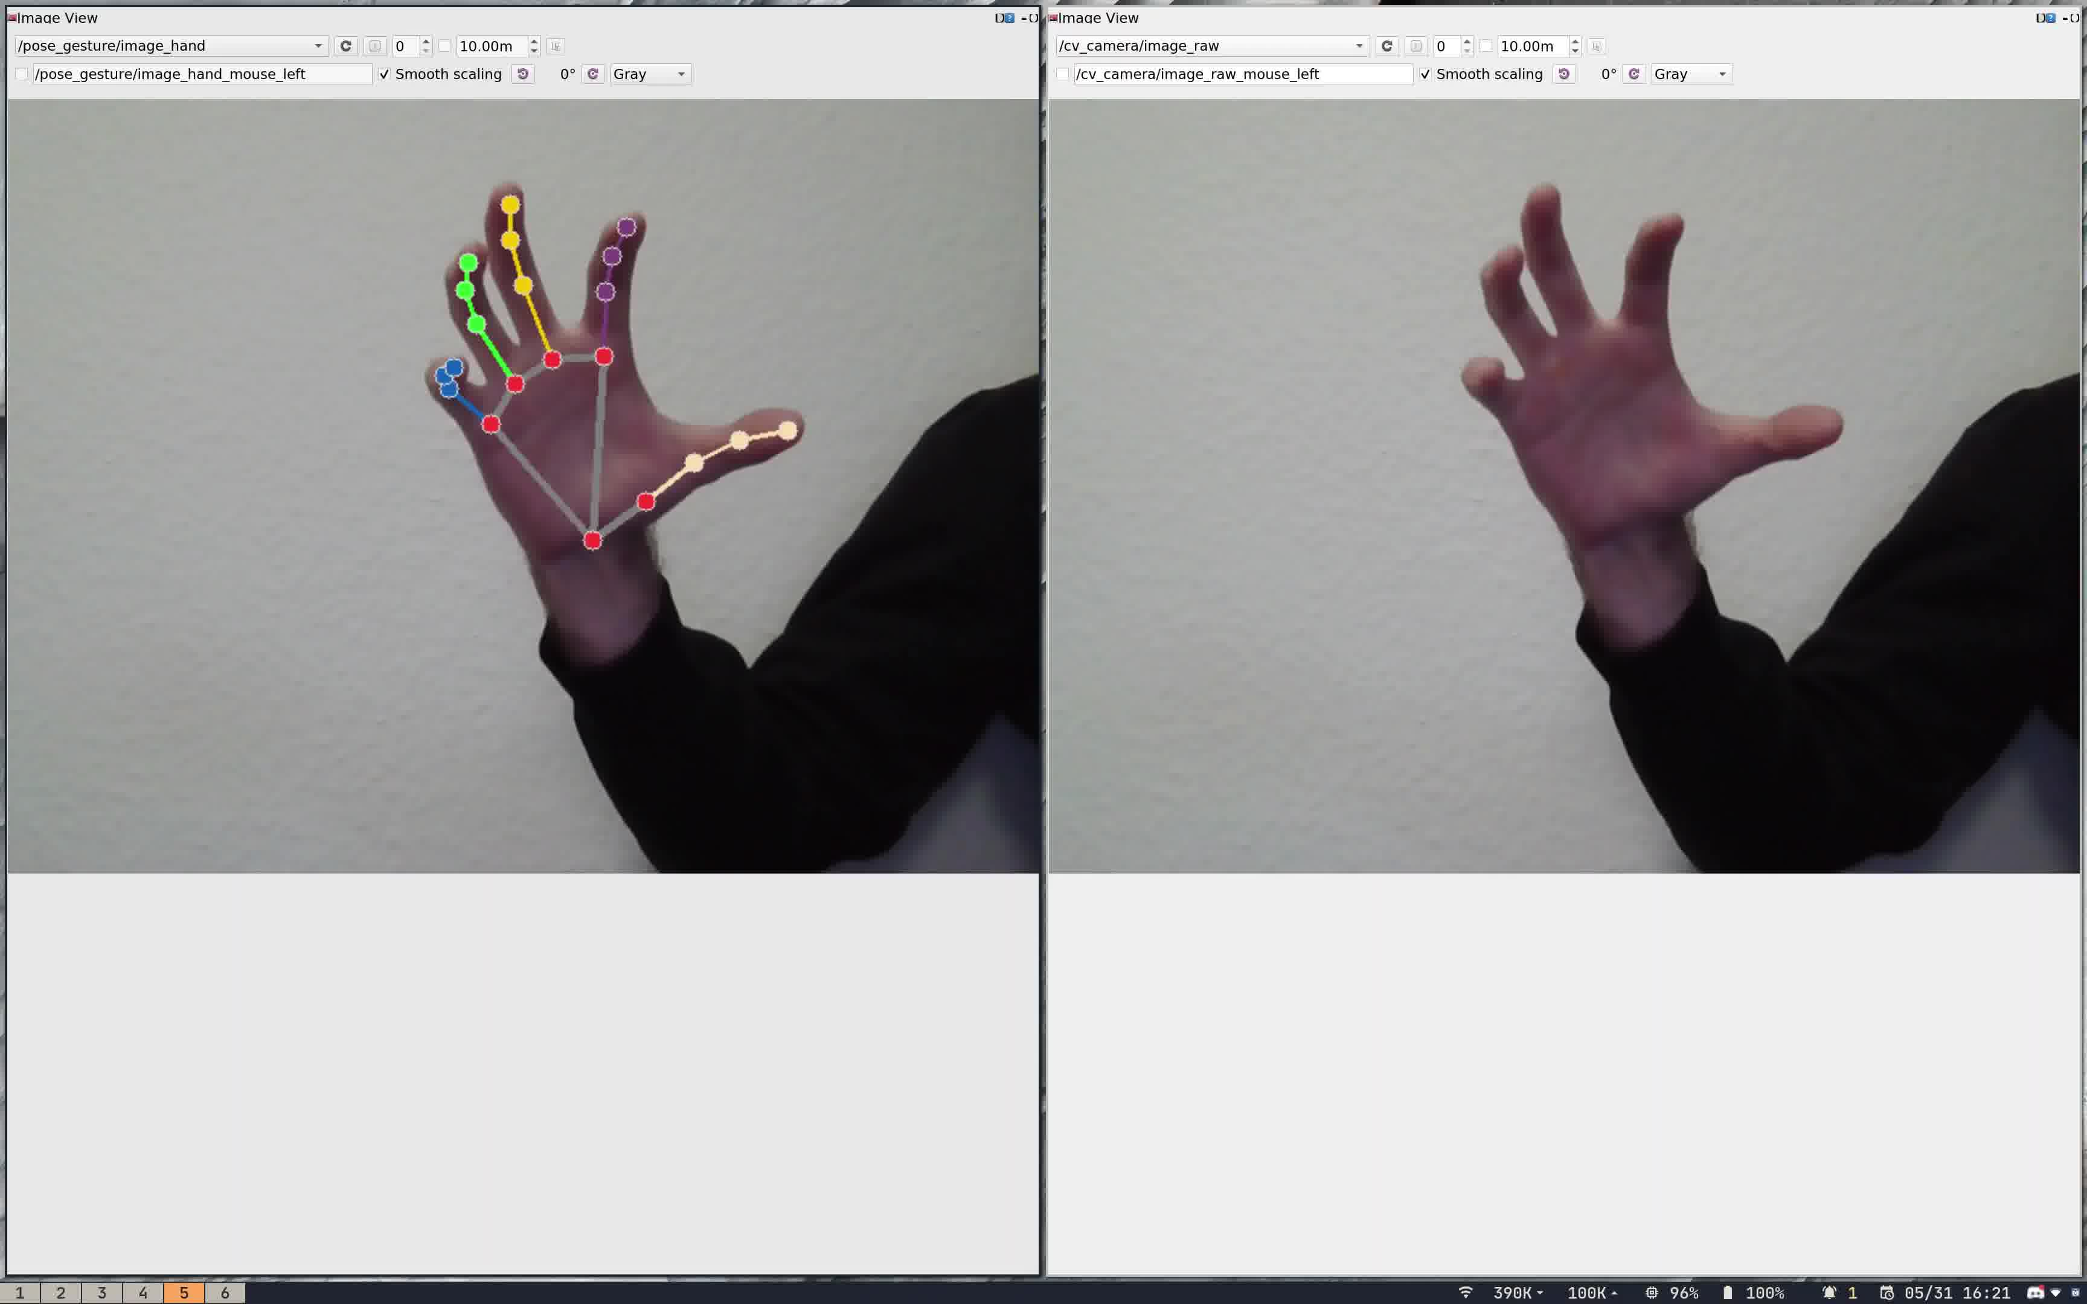
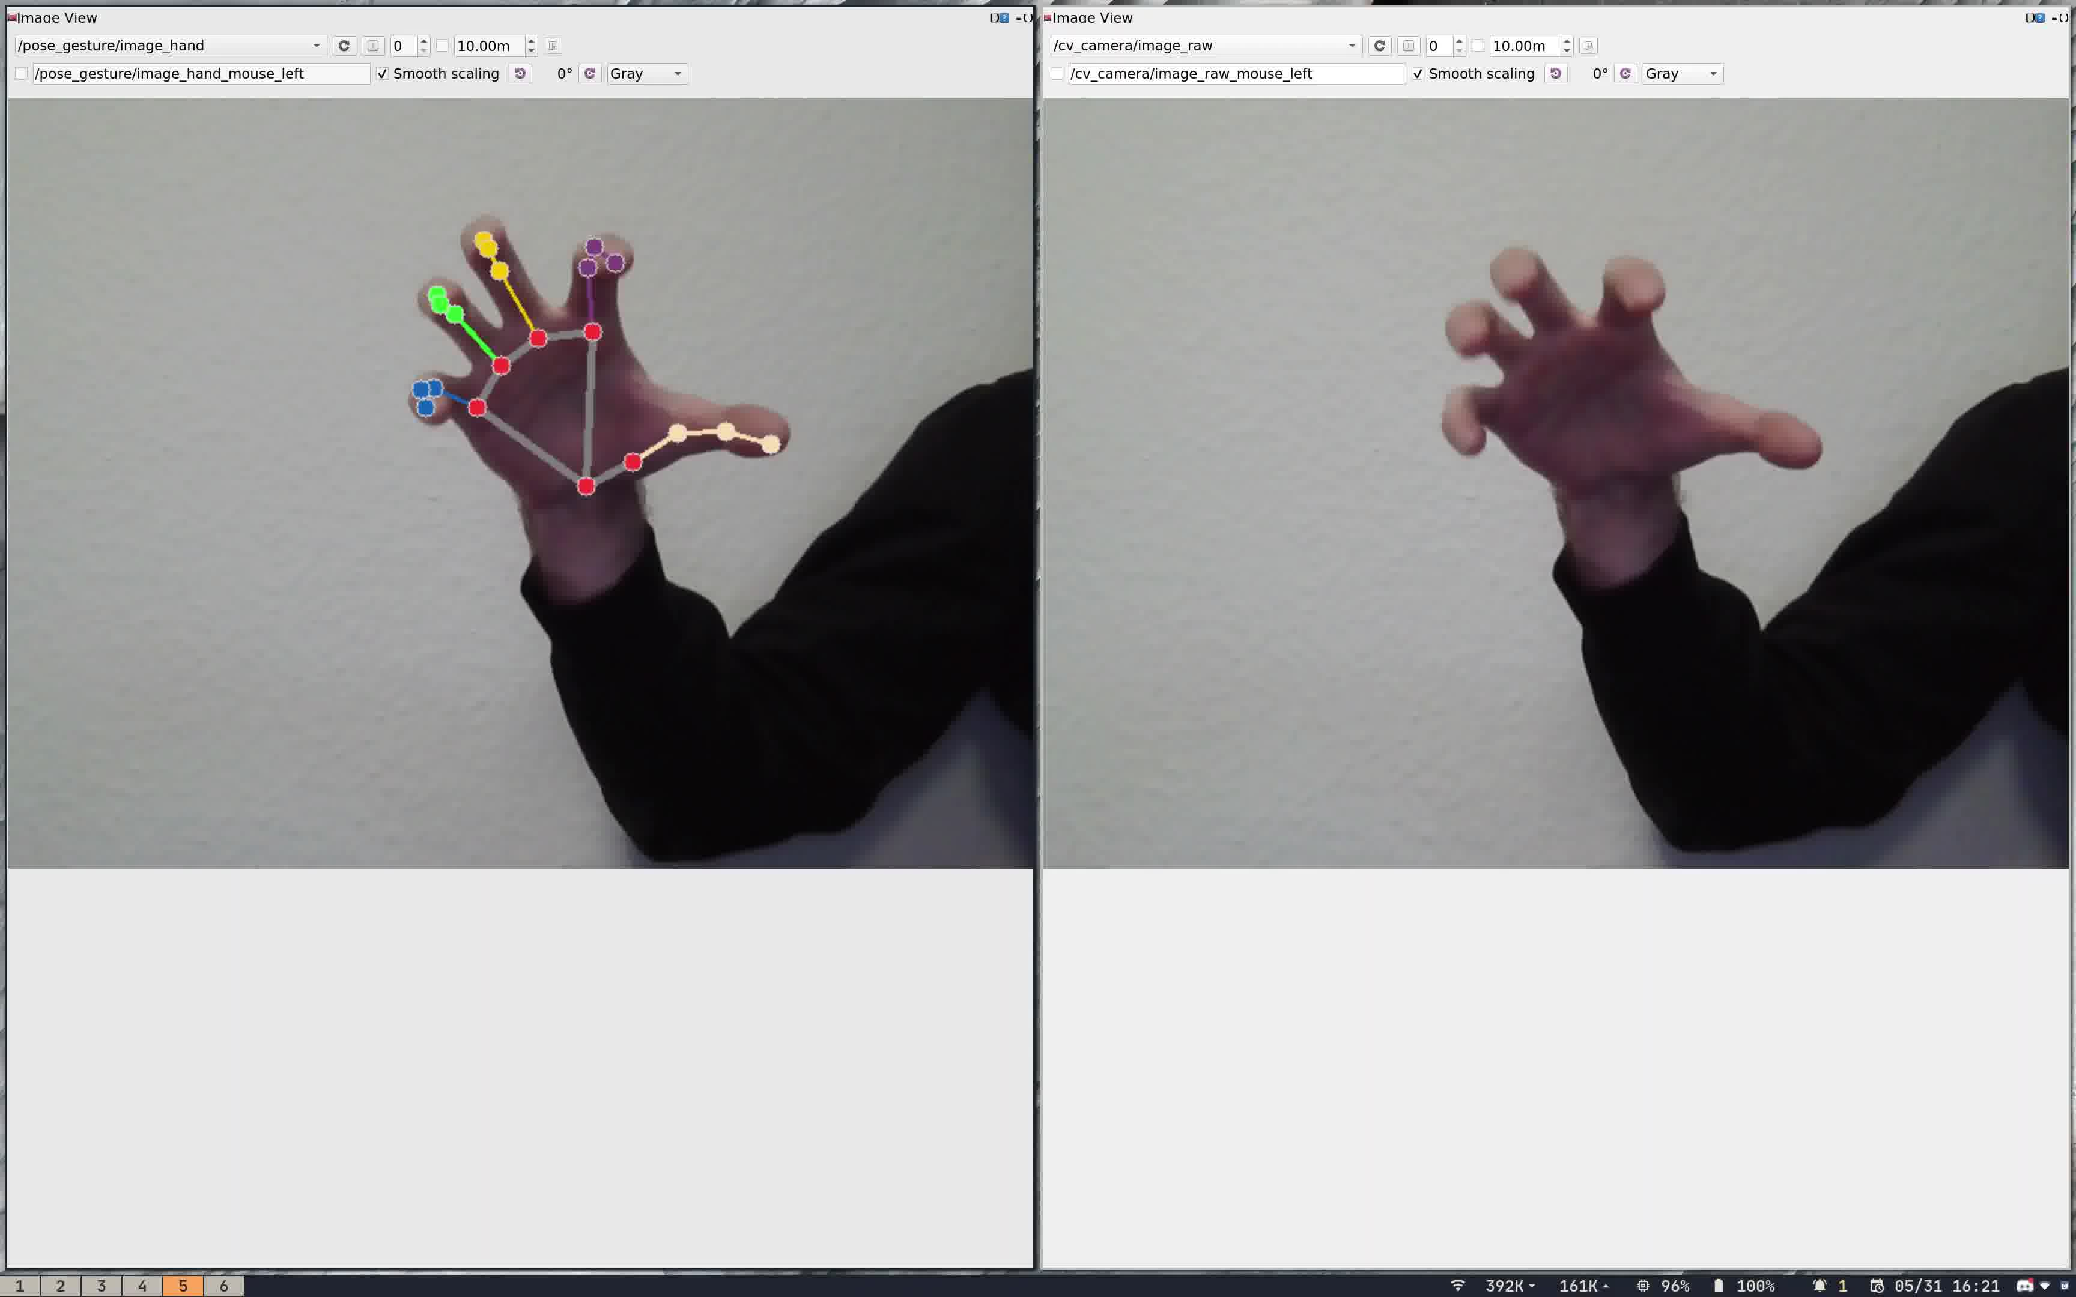
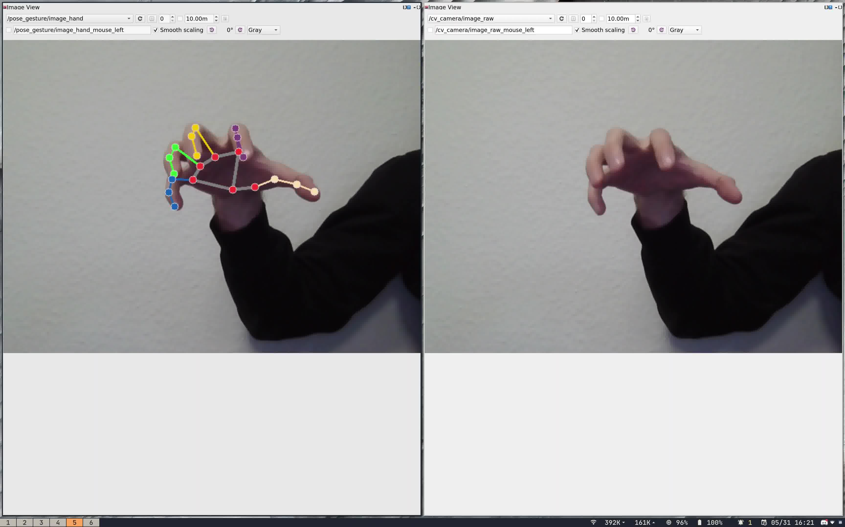

Slide 6
